Slide 1
Neural and Behavioral Representations of Social Ambiguity Among Adolescents and Adults
A Preliminary Examination Defense of an NIH Grant Proposal
Notes:
Hey everyone, Thanks so much for coming today to this defense.
I don’t really feel like I quite know how these things work,
but as I understand it, I present a little a bit, you ask me some questions, and we talk through some improvements.

Slide 2






Roadmap
Background
Project Summary & Significance
Analysis Details
Limitations, Issues, & Solutions
Strengths & Innovation
Future Directions
Notes:
I’m told that since you all read the proposal, I should not harp on that too much.
I’m going to start by laying a quick foundation of the project this proposal is primarily based upon.
I’ll briefly summarize the proposal and go over a few analysis details to place it in a context.
I’ll tackle some limitations and issues that I’m aware of, mention why we think this is innovative
and finish with where we could go next (i.e., how this relates to my dissertation, as I’m currently thinking about it.)

Slide 3
Uncertainty is a common feature of daily life
Notes:
So let me frame this by stating what I’ve tritely said in my fourth year talk and again in the grant that you read:
uncertainty is a common feature of daily life. We can be uncertain about a lot of things in our lives

Slide 4
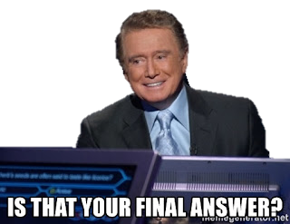
Notes:
facts

Slide 5
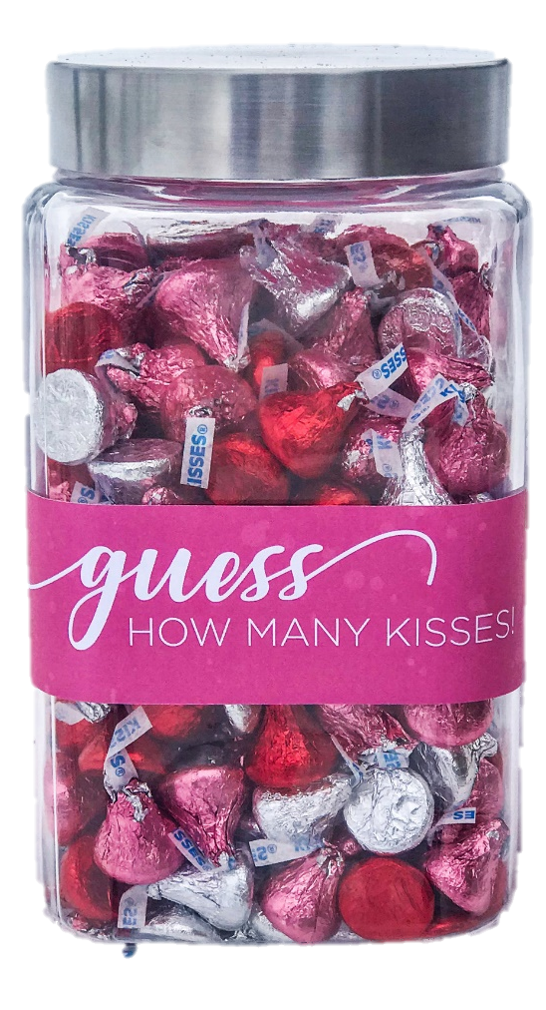
Notes:
calculations

Slide 6
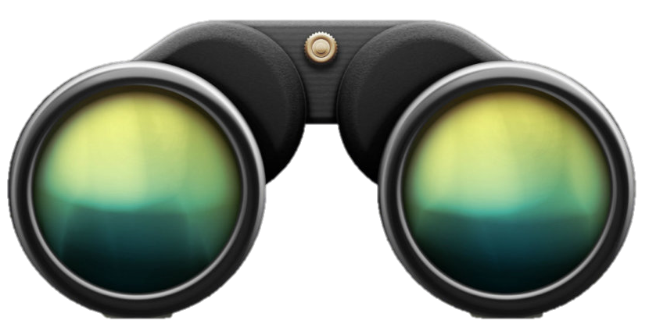
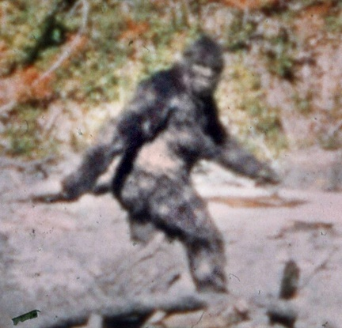
Notes:
Perceptions And we can measure how people form judgments of certainty in these domains

Slide 7
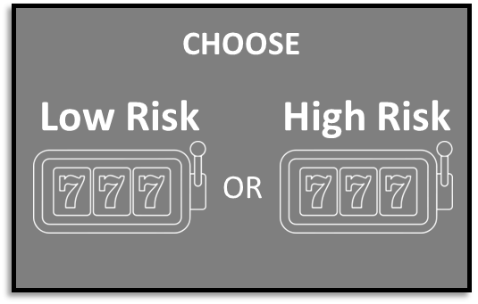

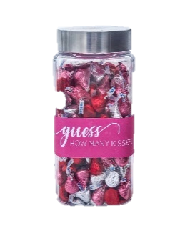
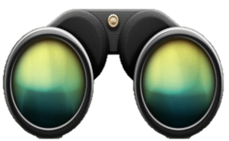

+
+
CHOOSE
Low Risk
High Risk
OR
Notes:
With well established trial by trial paradigms wherein participants make choices among known

Slide 8
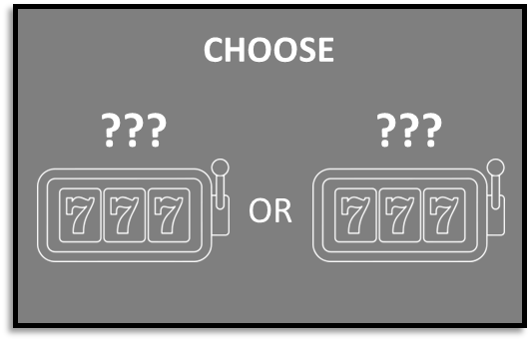
+
+
CHOOSE
Low Risk
High Risk
+
OR
+
CHOOSE
???
???
OR
Notes:
Or unknown outcome probabilities, often in the context of economic gains or losses

Slide 9
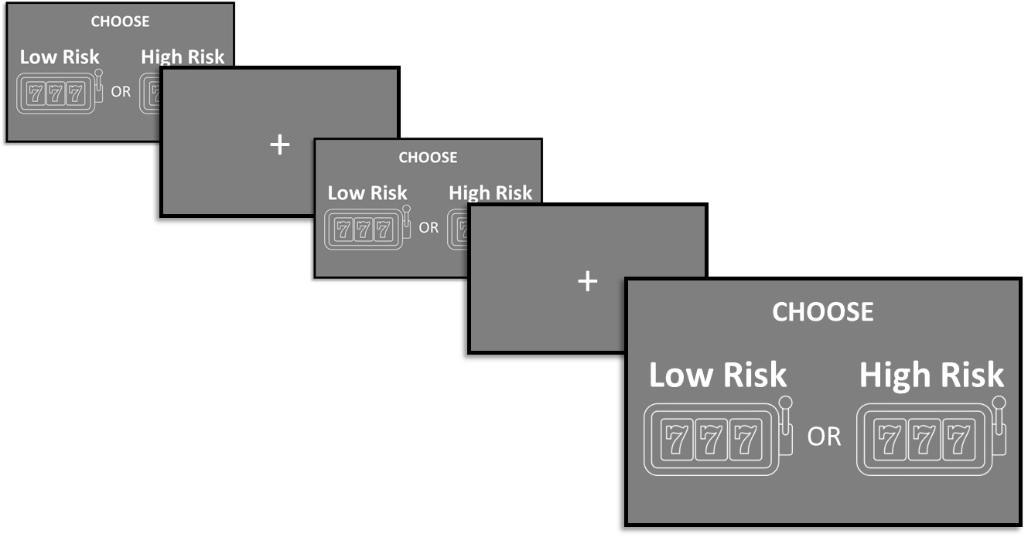


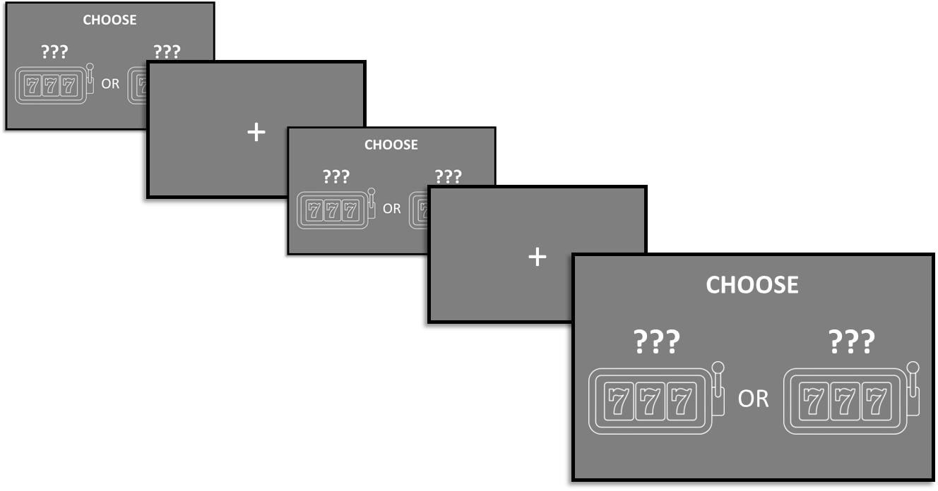
Notes:
These designs can sometimes be made social by pitting participants against real or fictitious others

Slide 10

Notes:
However, when we’re trying to read the faces of our new classmates

Slide 11
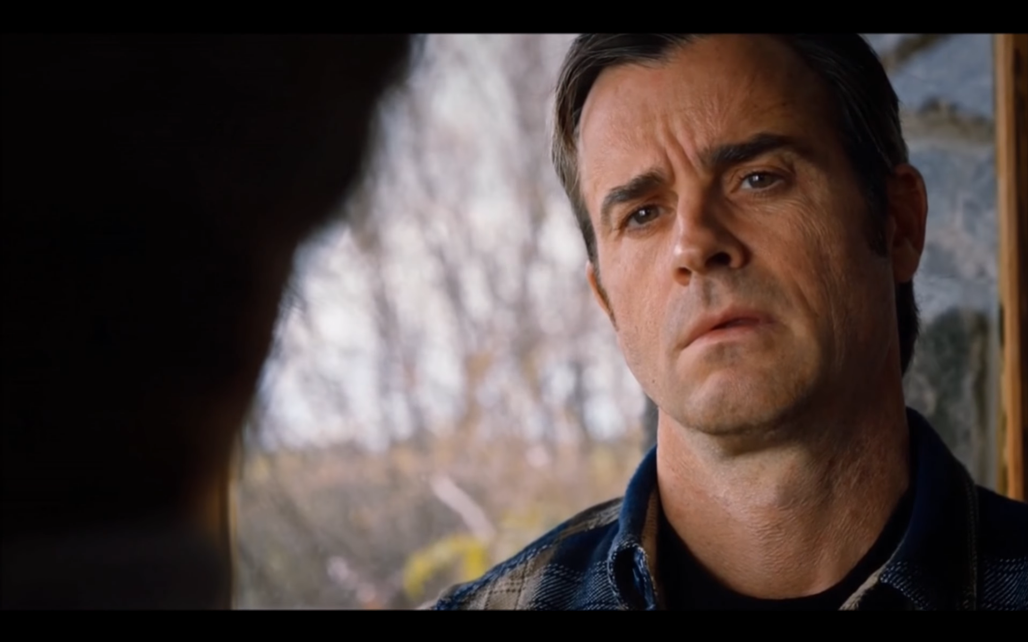
Notes:
Or figure out if the story we’re being told is a lie

Slide 12
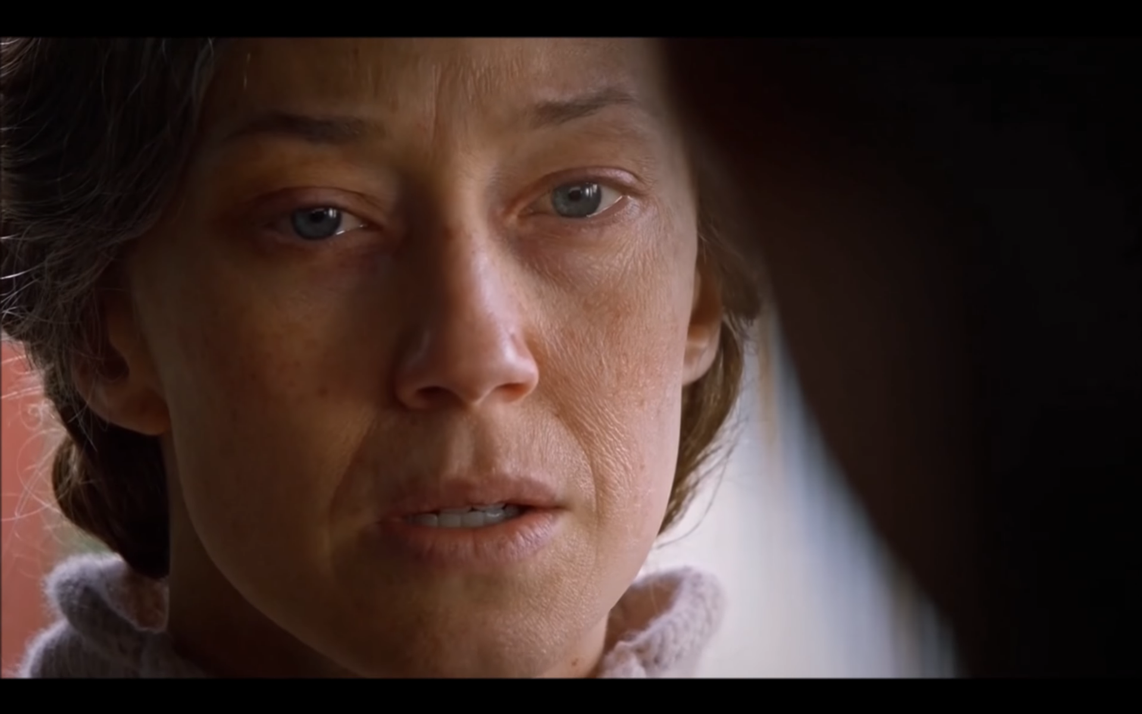
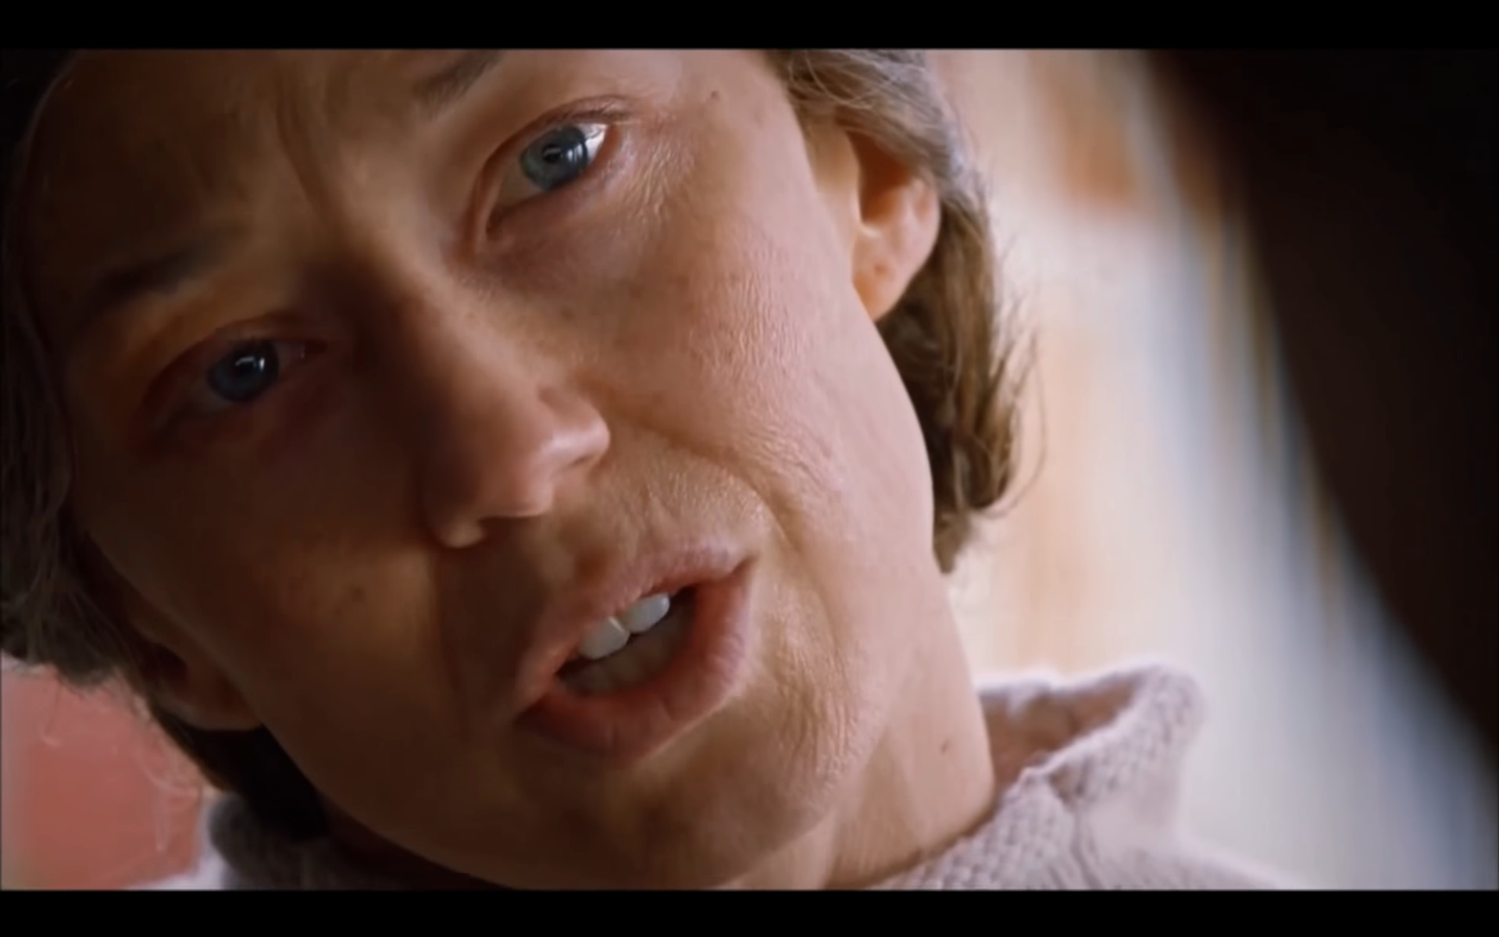
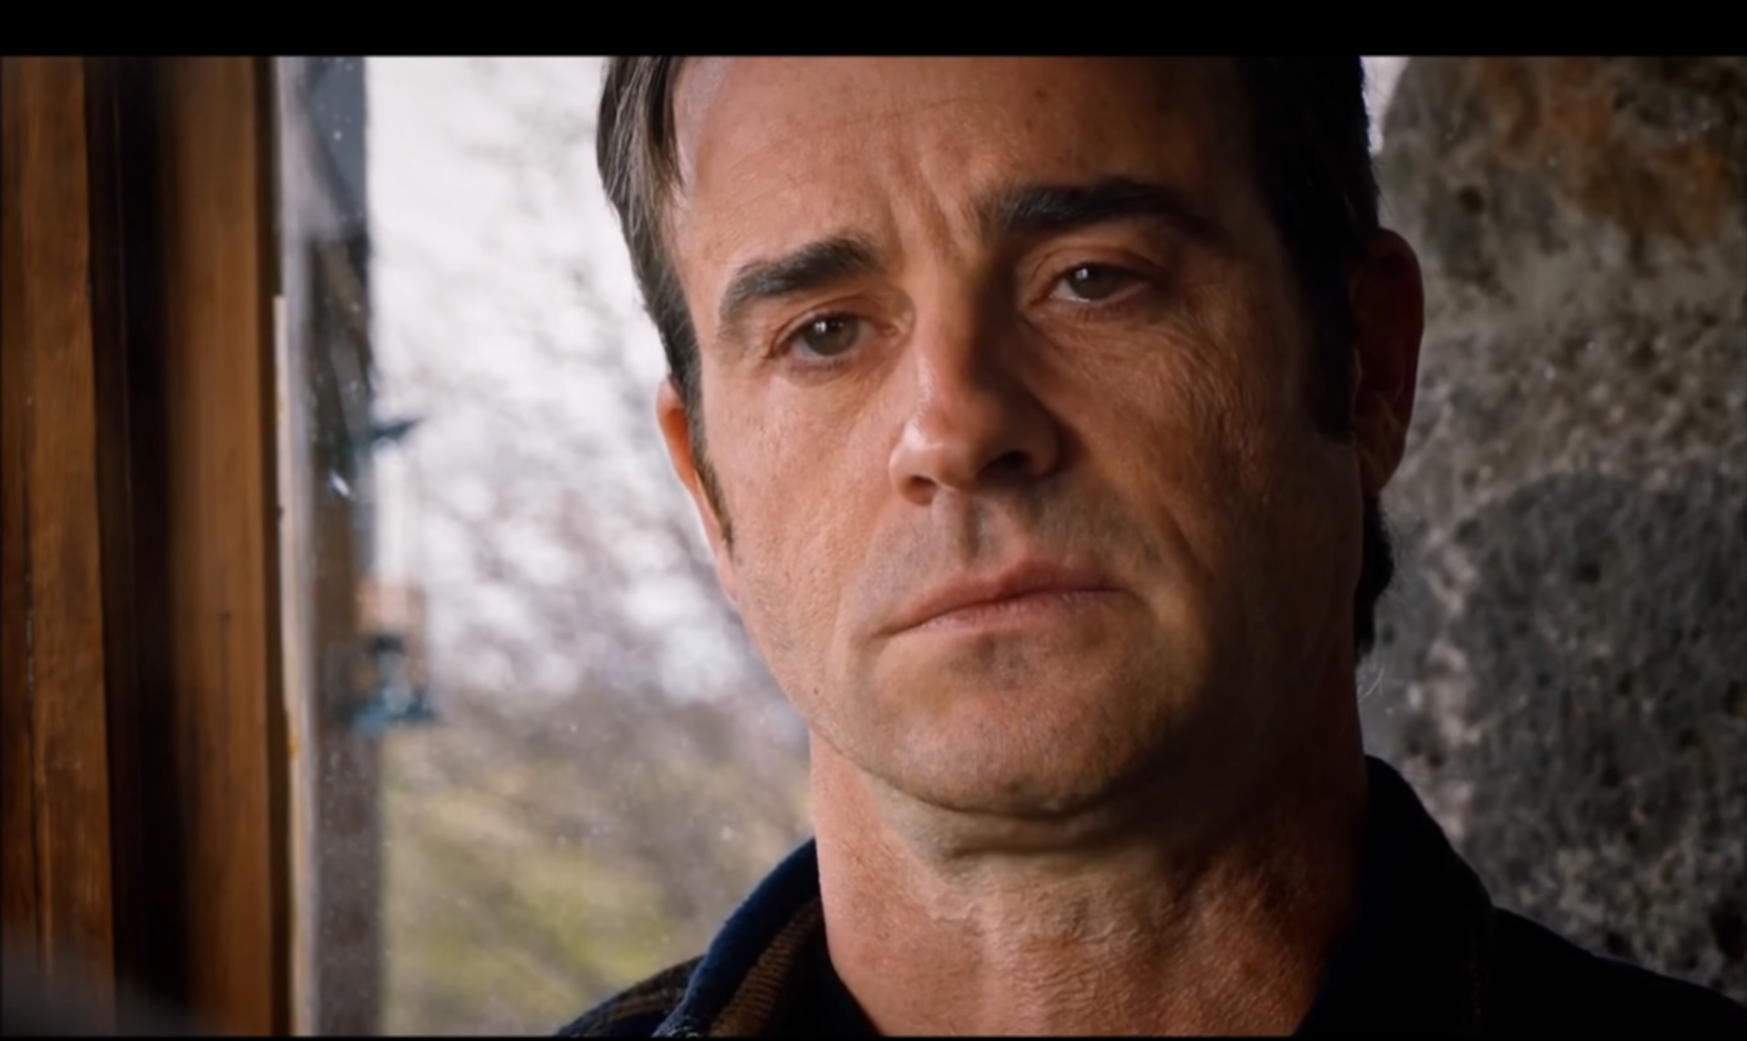
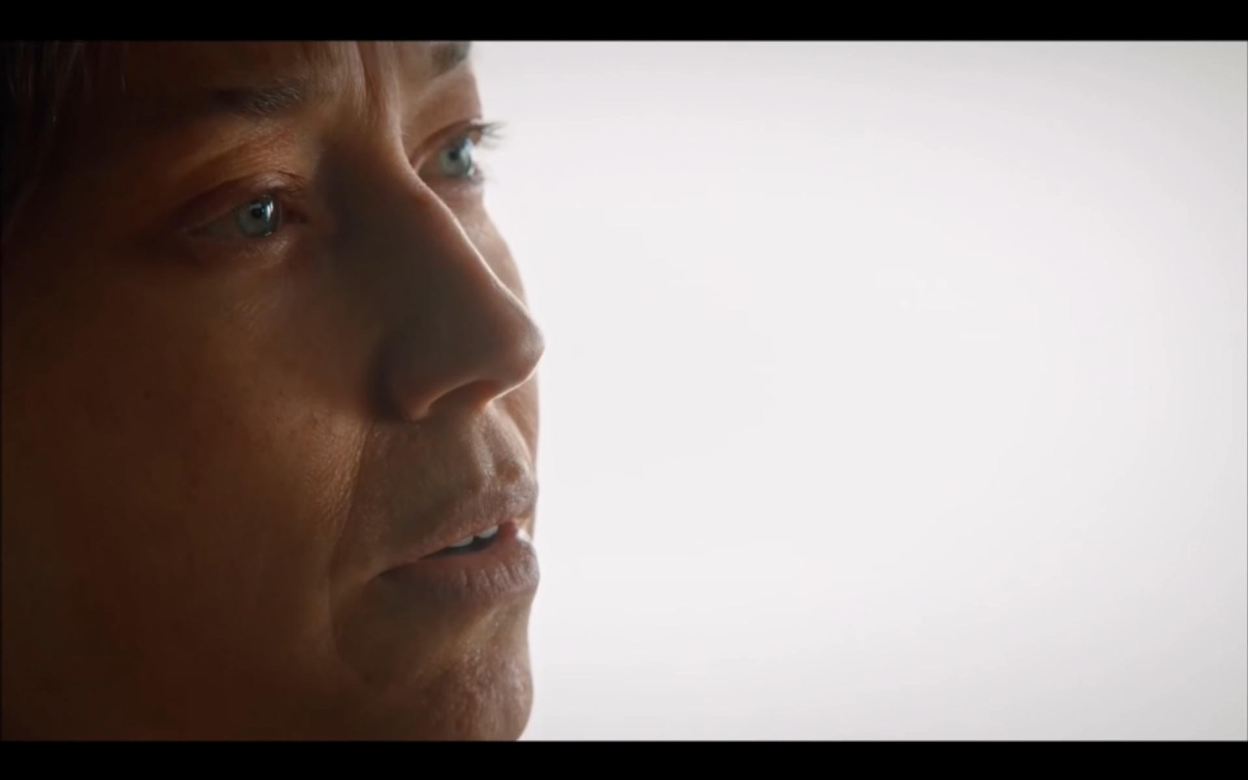
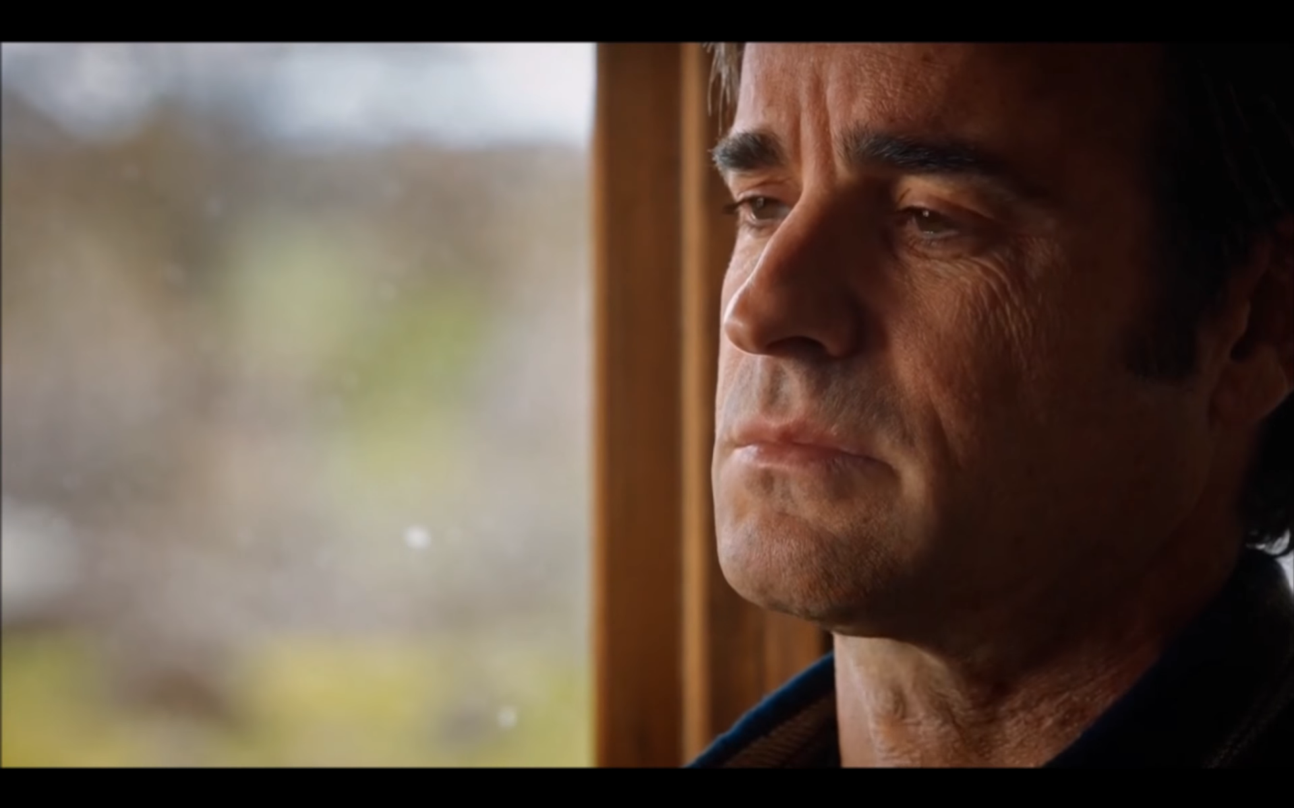
Plays out over a time course
Notes:
Information is revealed across a continuous time course or narrative rather than in neatly defined trials,

Slide 13
Plays out over a time course
May include irrelevant info
Notes:
Relevant information may be mixed with and need to be sorted from irrelevant information

Slide 14
Plays out over a time course
May include irrelevant info
Features unknown outcomes & probabilities
…
?
Notes:
And circumstances often feature both unknown possible outcomes and probabilities.

Slide 15

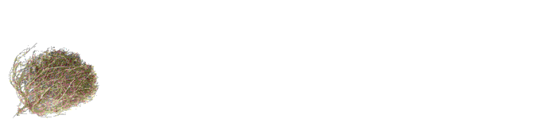
Plays out over a time course
May include irrelevant info
Features unknown outcomes & probabilities
Notes:
As such we aren’t aware of any well-established task designs currently in use that capture all of these important features.

Slide 16

We readily engage with ambiguous media
Notes:
However, all of these features are often present when we engage with ambiguous media, like movies or television shows

Slide 17

Notes:
So we designed a paradigm to examine how uncertainty forms over time in response to ambiguous social sources
using a very high quality but not very well known drama called the Undoing.

Slide 18
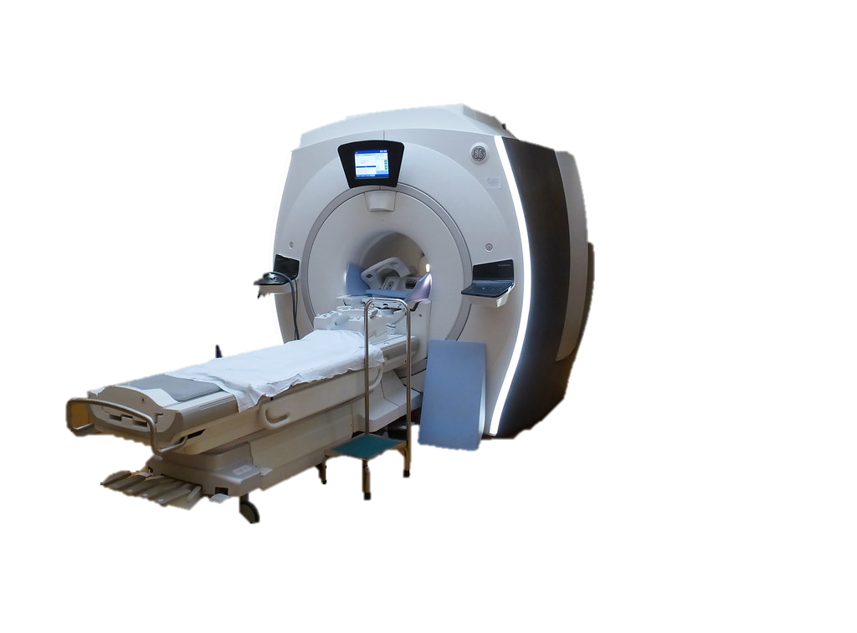
Notes:
In our study design, participants who have never seen the show before enter a scanner.

Slide 19
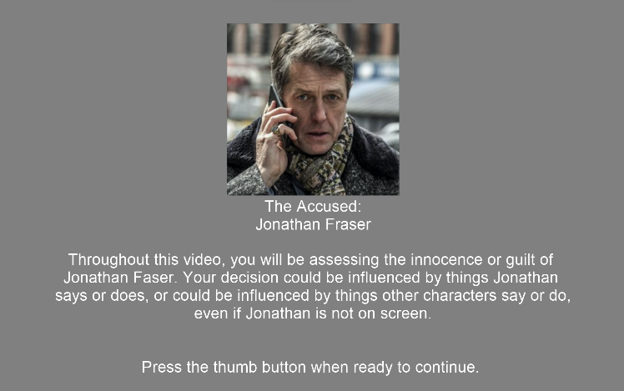
Notes:
They’re provided with background information about the clip they are about to watch, including the names of characters and which character they will be tracking during the task.

Slide 20
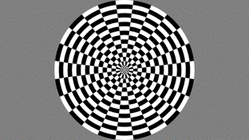
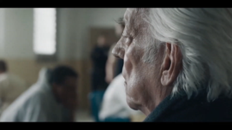

30s
+
30s
22m 17s
100%
00%
100%
Guilty
Innocent
00% Certain
Notes:
Then watch the episodes and use a button box to continuously update how certain they are
that an accused primary character is either innocent or guilty while watching the clip.

Slide 21
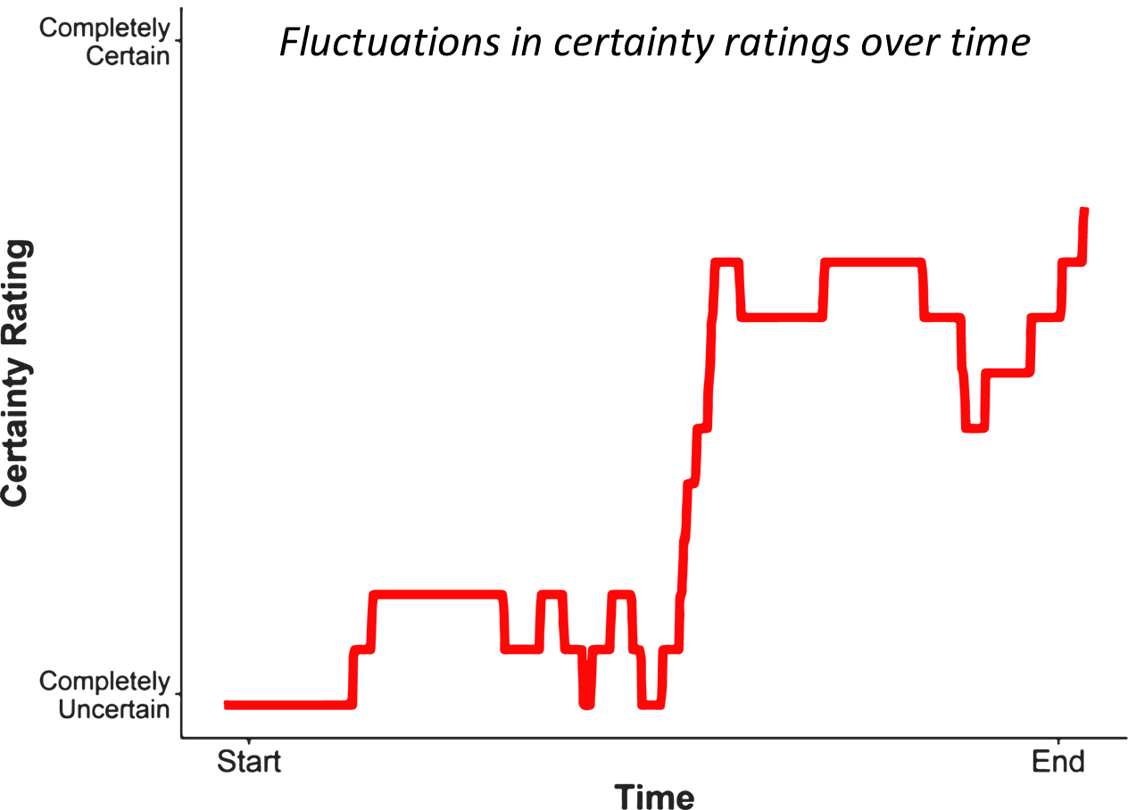

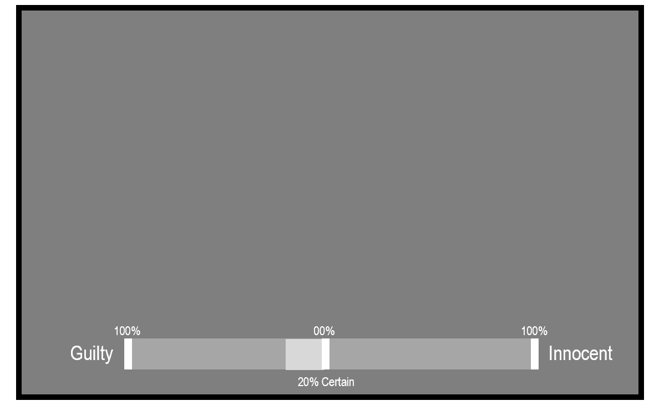
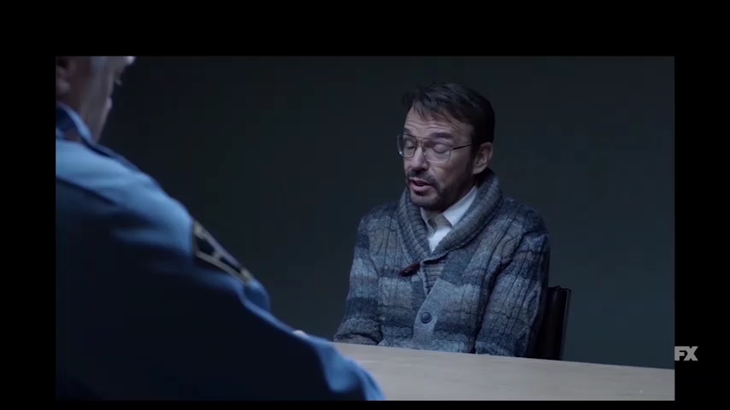

Notes:
We can collect behavioral data [CLICK] from each participant
over time as events unfold
and, even better,

Slide 23

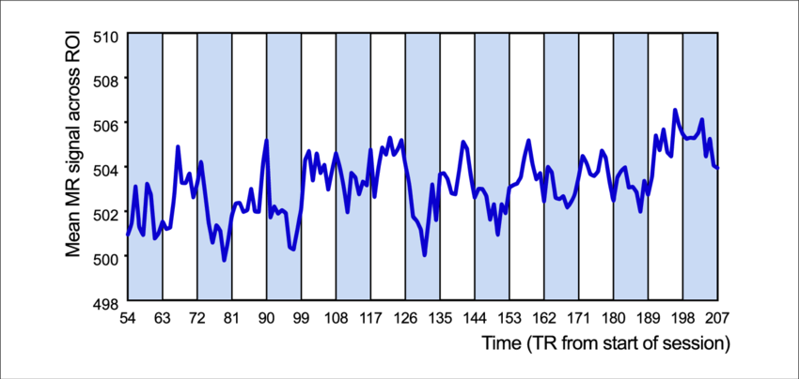
Notes:
We can examine that behavioral activity in conjunction with neural activity, which will be time locked together.

Slide 24
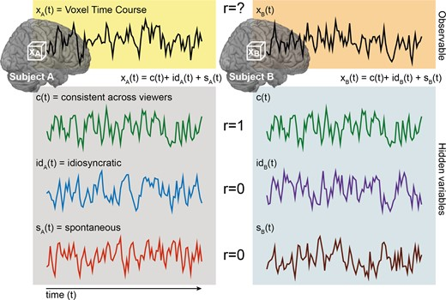
From Nastase et al., 2019
Notes:
When we examine fMRI brain activity using naturalistic stimulation conditions, data can be thought to be generated by three or four main sources, depending upon who you ask. These include:

Slide 25
From Nastase et al., 2019
Notes:
stimulus-driven brain activity between individuals shared by all or most of the participants
This is activity that is a direct product of the manipulation or stimulus you are applying

Slide 26
From Nastase et al., 2019
Notes:
individual or idiosyncratic activity elicited by the stimulus that is still time-locked to the stimulus.
These might include unique cognitions or thoughts,
like perhaps making a connection between what a character said earlier with a clue they are saying now

Slide 27
From Nastase et al., 2019
Notes:
And lastly intrinsic activity that is not time-locked to the stimulus, and noise from other various sources.
For our perspective, this is mostly noise. This could be representational drift, or MR-related static in the latter case,
as well as just random intrusive thoughts or observations in the former case.

Slide 28




Examining intersubject correlations in uncertainty representations
Notes:
What we’re generally interested in doing with this approach is an intersubject correlation
and these types of approaches tend to be really great at examining the large scale group similarities we see in the first type of data source.

Slide 29
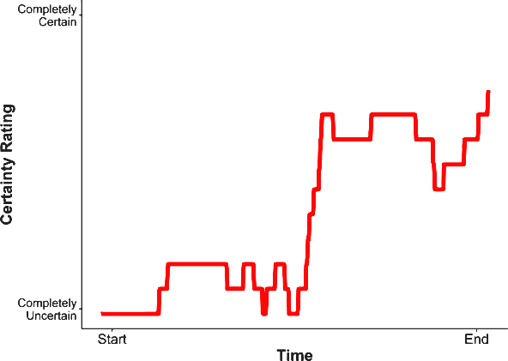
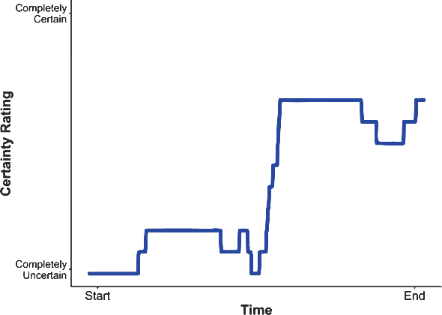
Do people who process information similarity …
Notes:
So we could do things like compare people who apprear to process information similarly,
based upon things like their behavioral representations of uncertainty

Slide 30
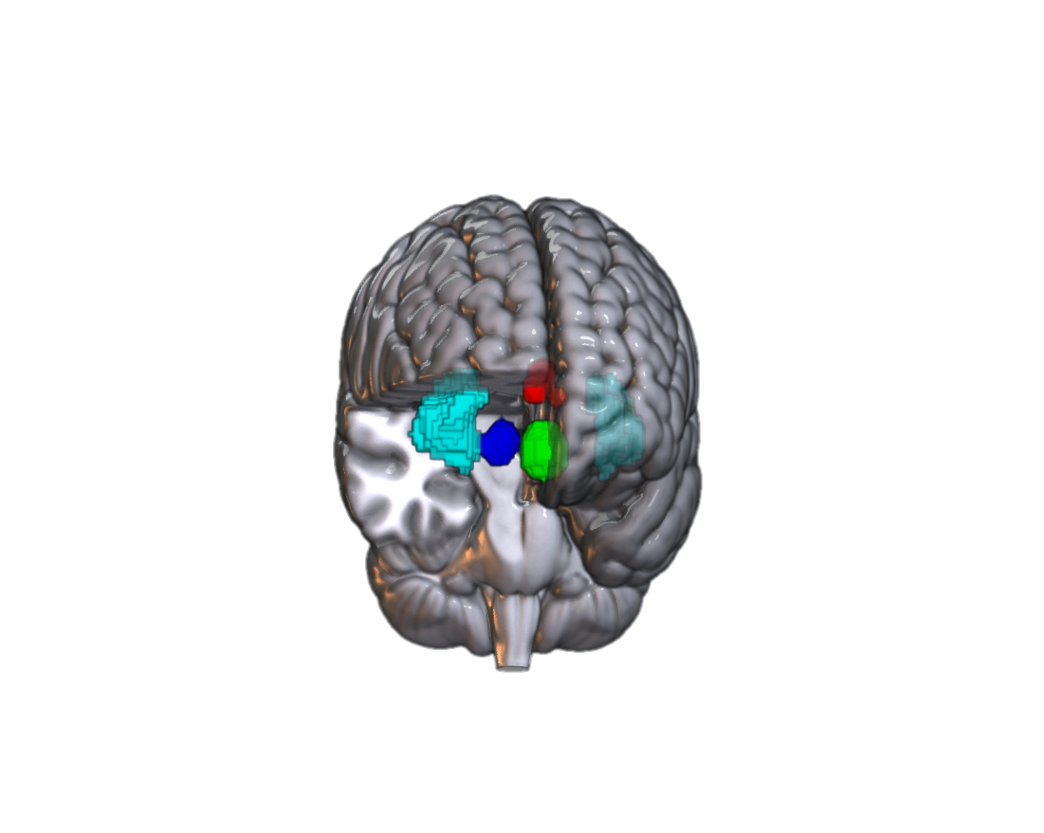

Do people who process information similarity … demonstrate similar neural representations in key networks
Notes:
And examine how similarly they demonstrate neural representations in key cortical networks
Spoiler alert or sort of off the record. If the grant doesn’t get funded, we’ll likely stick to this approach.
However, if we can get an adolescent population an intersubject representational similarity analysis will be really interesting,
but I’m getting ahead of myself a bit

Slide 31
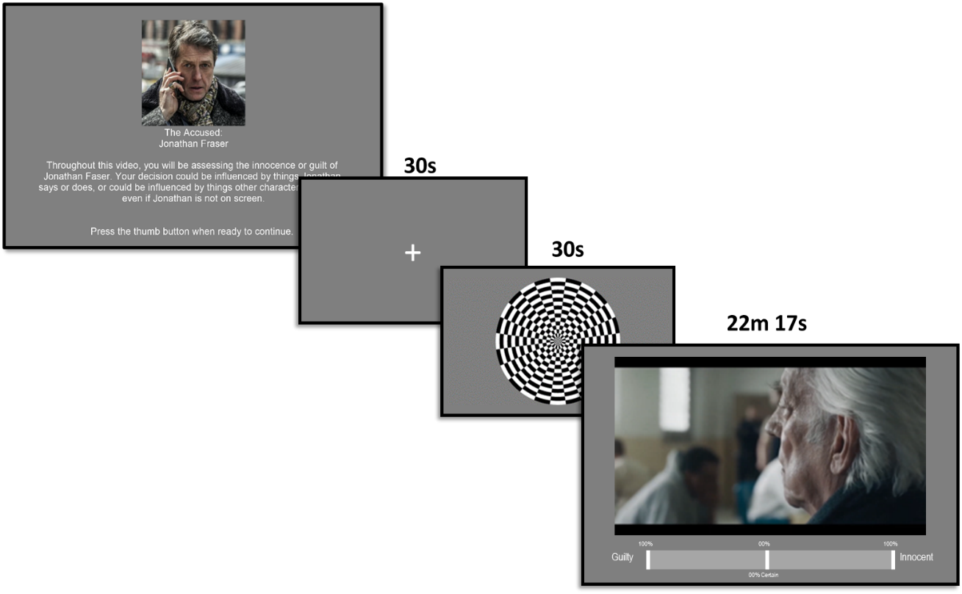
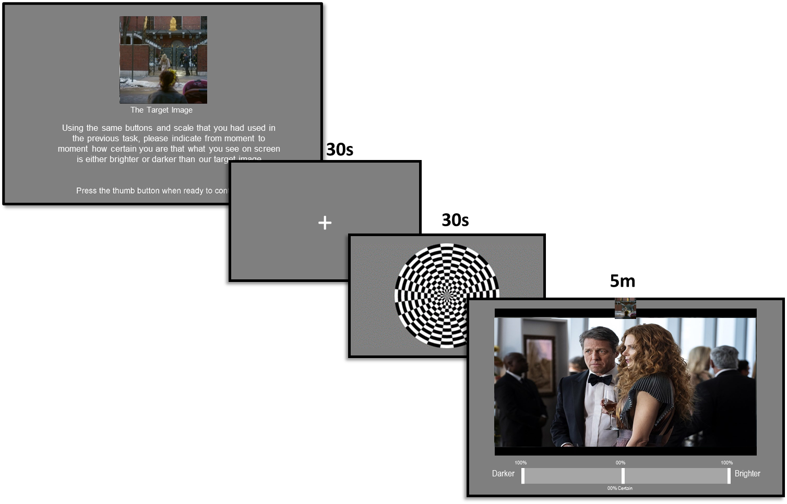






SOCIAL AMBIGUITY TASK
2 RUNS
PERCEPTUAL AMBIGUITY TASK
FREE
RECALL TASK
INDIVIDUAL
DIFFERENCE MEASURES
Notes:
Either way, we’re going to be able to do all of these analyses because of the different types of data that we’re collecting Te structure of a session looks like this:
After completing two runs of the primary task that I just described,

Slide 32
SOCIAL AMBIGUITY TASK
2 RUNS
PERCEPTUAL AMBIGUITY TASK
FREE
RECALL TASK
INDIVIDUAL
DIFFERENCE MEASURES
Notes:
we then have participants complete a third run,
but this time, we ask them to track the luminance of the video, frame by frame,
and indicate how certain they are the target frame is brighter or darker than a target image.

Slide 33
SOCIAL AMBIGUITY TASK
How social uncertainty judgments differ non-social uncertainty judgments?
2 RUNS
PERCEPTUAL AMBIGUITY TASK
FREE
RECALL TASK
INDIVIDUAL
DIFFERENCE MEASURES
Notes:
With this data, we can begin to explore differences in how social and non-social certainty judgements form.
We can examine which regions are differentially responding to each category
by using behavioral ratings as parametric predictors upon neural activation.
Unfortunately, some of the more interesting analyses using the features of the stimulus won’t really apply here,
So I’m going to move on to the next component of the session

Slide 34
SOCIAL AMBIGUITY TASK
2 RUNS
PERCEPTUAL AMBIGUITY TASK
FREE
RECALL TASK
INDIVIDUAL
DIFFERENCE MEASURES
Notes:
Following the ambiguity tasks, participants complete a surprise free recall task,
in which they are asked to recite, in chronological order if possible,
as many events and details from the social ambiguity task as possible.

Slide 35
SOCIAL AMBIGUITY TASK
2 RUNS
How are ambiguous / unambiguous events represented in attention and memory?
PERCEPTUAL AMBIGUITY TASK
FREE
RECALL TASK
INDIVIDUAL
DIFFERENCE MEASURES
Notes:
This is one of the most exciting features of the design
because through this free recall we can identify which events participants remember well,
which they do not,
how linear their recall had been,
and explore how their judgment formation informs their later performance.

Slide 36

SOCIAL AMBIGUITY TASK
2 RUNS
How are ambiguous / unambiguous events represented in attention and memory?
PERCEPTUAL AMBIGUITY TASK
FREE
RECALL TASK
INDIVIDUAL
DIFFERENCE MEASURES
Notes:
It should be noted that one of our wonderful RAs has gone through an annotated the entire episode,
so for any given TR, we know things like exactly which characters are on screen,
Where the scene is occurring,
Whether there is legible writing visible.
We’re hoping to supplement this with work from independent raters
who will make value assessments of the evidence from moment to moment.
And so all of this gives us a lot of tools to quantify people’s attention to and memory of features of the stimulus
So we can then begin to build associations between those things and behavioral and neural representations

Slide 37
SOCIAL AMBIGUITY TASK
2 RUNS
PERCEPTUAL AMBIGUITY TASK
FREE
RECALL TASK
INDIVIDUAL
DIFFERENCE MEASURES
Notes:
And lastly we’ll collect a number of individual difference measures participants’ hypotheses at the end of each run, and character assessments.

Slide 38
SOCIAL AMBIGUITY TASK
2 RUNS
PERCEPTUAL AMBIGUITY TASK
X 1
FREE
RECALL TASK
INDIVIDUAL
DIFFERENCE MEASURES
Notes:
Something I didn’t mention earlier,
but a potential limitation of the study is that we are not actually collecting ratings
from participants in both of the social ambiguity runs,
but in fact one run is rated and the other is passively viewed,
and we randomize which is which with each participant

Slide 39
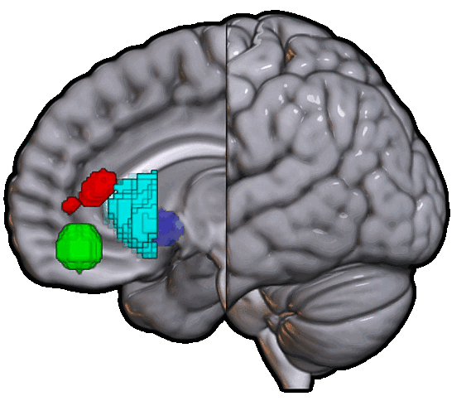
dACC
VS
OFC
AI
Notes:
The preliminary analyses have been fairly promising.
We hypothesized activity in a few key regions

Slide 40
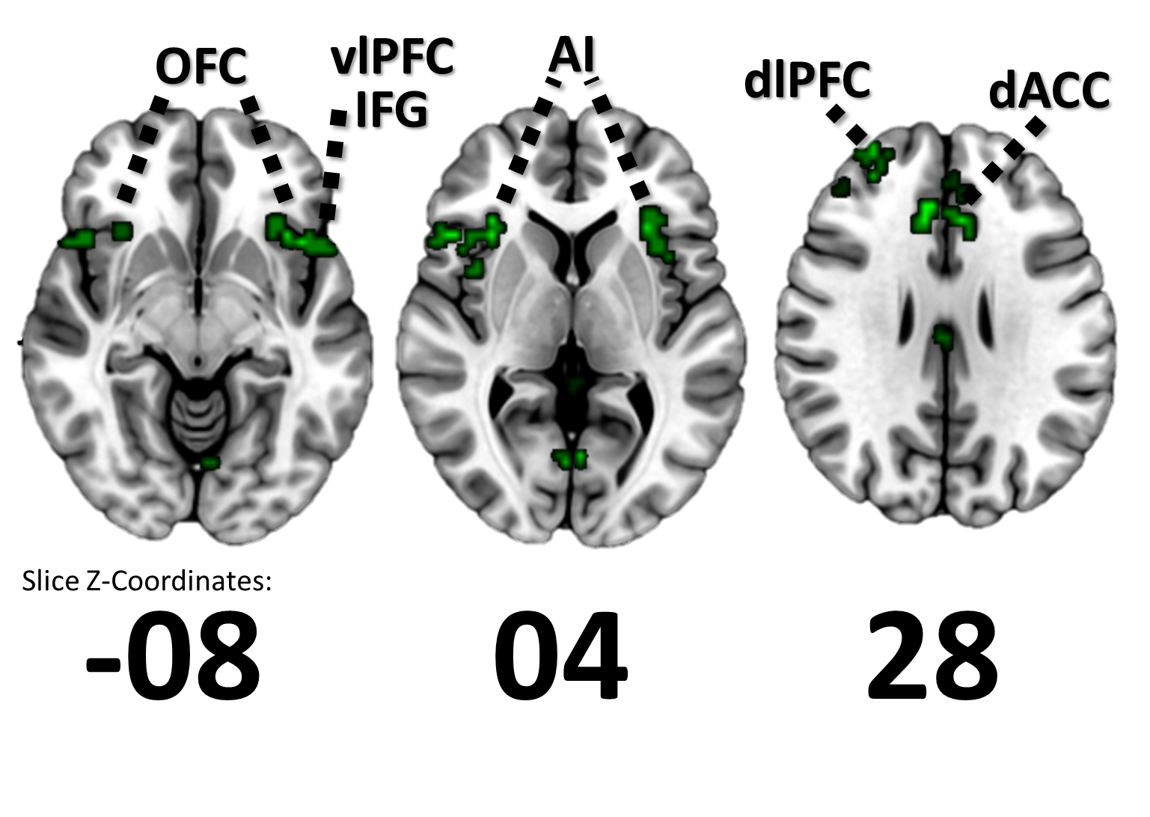
dACC
VS
OFC
AI
Notes:
And we’re seeing those regions light up almost exactly.
However, this is just a preliminary univariate analysis to see if we’re sort of hitting the areas we’d expect to hit.
I can get more into how I calculated this if interested.
Thus far, we’ve only collected data from twenty six people and all of those individuals are adults,

Slide 41
F99 Phase Dissertation Research
Exploring the formation of outcome-based social uncertainty judgements across normative adolescent development
Notes:
leading me to what I’ve proposed in the F99 phase of this grant.
I’m simply proposing that we extend this paradigm to include adolescents as young as 13 years old
and perform a slightly different set of analyses.

Slide 42
AMBIGUITY
Notes:
As we’ve said time and time again, introducing ambiguity into a stimulus or situation can be fairly aversive

Slide 43

AMBIGUITY
Notes:
And many studies have demonstrated that adults demonstrate significant ambiguity aversion
They don’t like it, they try to avoid it, in both social and economic domains

Slide 44
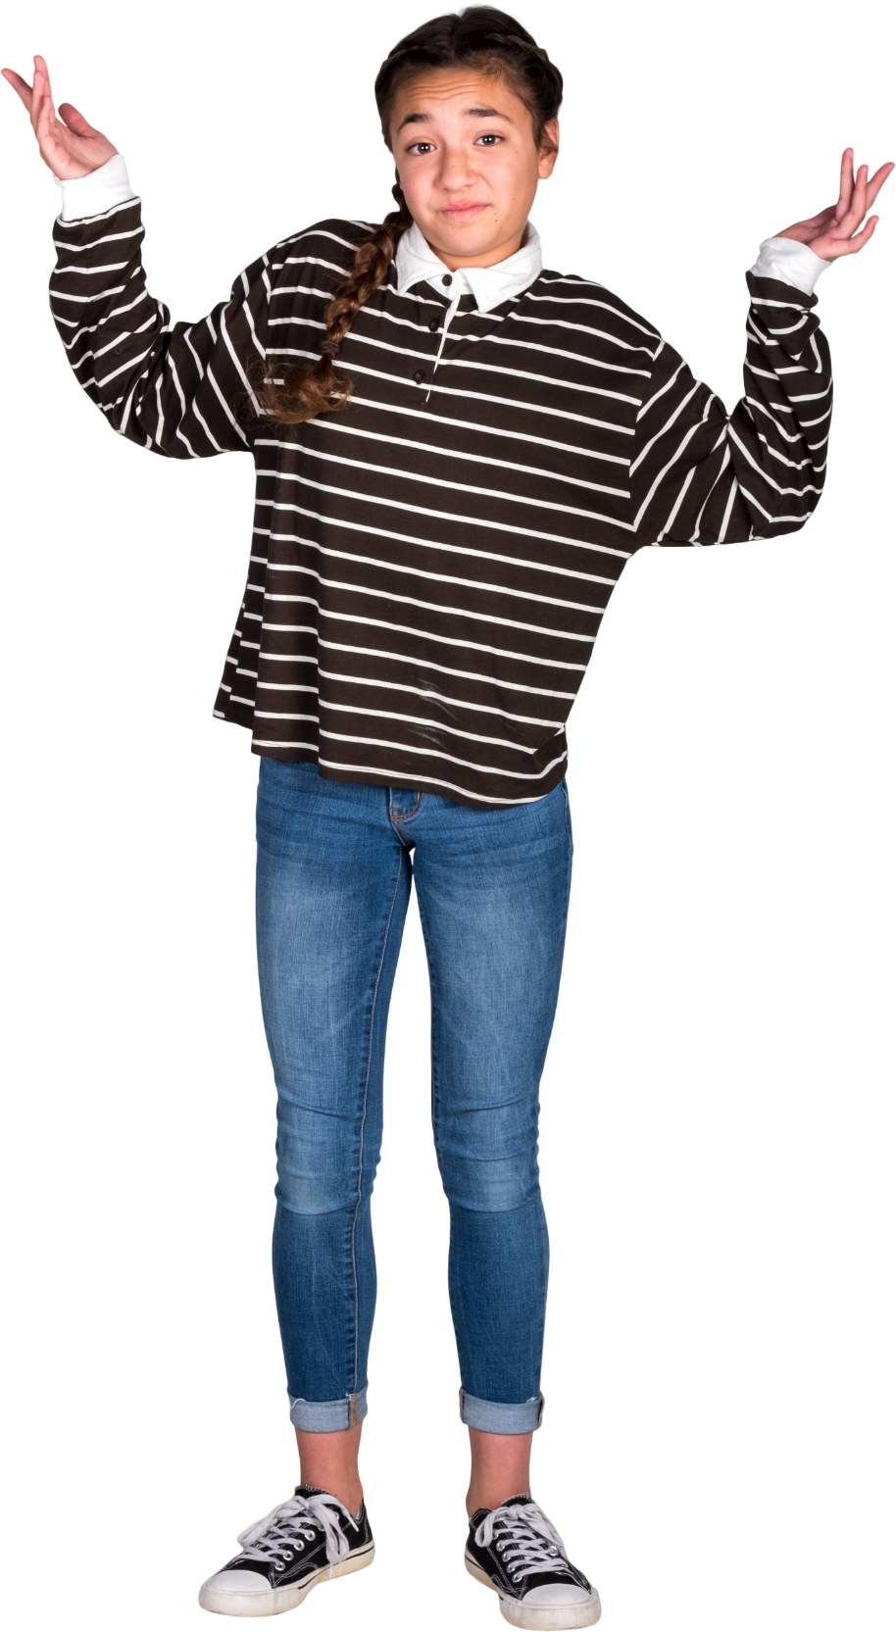
AMBIGUITY
Notes:
However, interestingly enough, kids consistently fail to demonstrate ambiguity aversion

Slide 45


AMBIGUITY
ECONOMIC
Notes:
This has most often been explored in the context of economic ambiguity

Slide 46
AMBIGUITY
ECONOMIC
AMBIGUITY
SOCIAL
Notes:
Which has led some researchers to infer that it’s the case for social ambiguity as well
But to the best of our knowledge, no research has actually been conducted upon teens
Using social sources of ambiguity, just socializing economic ones.
Researchers have tried explaining this through familiarity biases or pessimistic attitudes

Slide 47

Notes:
Interestingly enough fear of peer rejection, does appear to demonstrate some predictive utility towards this
Which makes sense given that adolescents is a period in which we’re more attuned to social others.
It should be the case that adolescents are sensitive to social ambiguity

Slide 48

AMBIGUITY
Notes:
And we’re indirectly found this to be the case in studies where social ambiguity early in adolescents predicted later depression and anxiety susceptibility

Slide 49

How similarly do adolescents and adults form certainty judgments?
Notes:
But as of yet we haven’t actually mapped how adolescents form these judgments and how they differ from adults.

Slide 50
How similarly do adolescents and adults form certainty judgments?
The reason why we see differences in response might lie in the features these groups attend to and how they hypothesis test over time
Notes:
Examining how similarly social sources of ambiguity are represented across a time course
with a feature rich stimulus might highlight important differences
in how adults and adolescents process information and which features they attend to.
While we likely could not yet conclude whether this informs differences in feelings of aversion,
it gives us a greater understanding of the space and provides clues for other places to look.

Slide 51
Notes:
If you think back to this graphic we’d looked at earlier, I’d mentioned that ISC is really great at examining data
Consistent across participants.

Slide 52
Notes:
What we’re proposing here, would sort of be somewhere a step down,
in which we are trying to identify activity might look idiosyncratic en masse,
but which is consistent across smaller groups of individuals

Slide 53
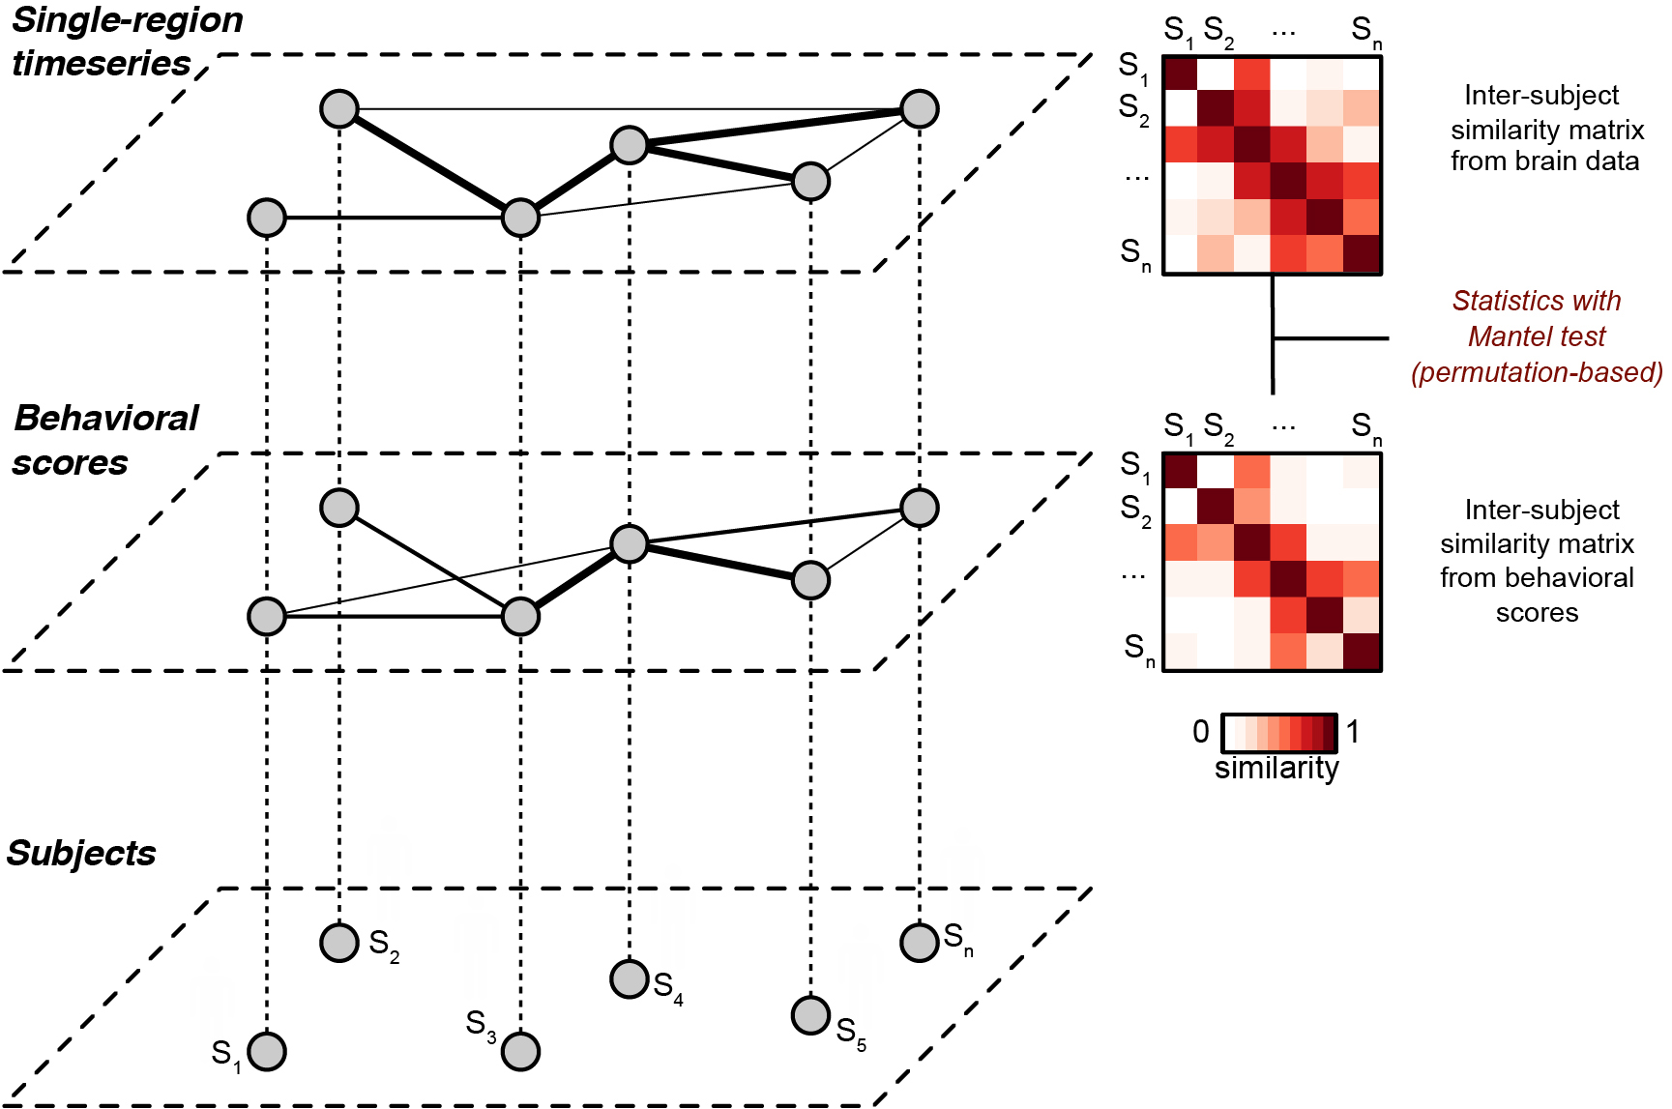
Notes:
This is a figure which I took from the Luke Change Naturalistic Data Workbook emphasizing how IS-RSA approaches are used
Starting with individual subjects at the lowest level, behavioral scores in the middle and neural data at the top,
And we’re observing distance and clustering as activity and features grow more or less similar from one another.

Slide 54
Notes:
In the context of our study,
We can examine how similar participants are in their ratings, in their individual difference measures ,and their free recalls

Slide 55
Notes:
We could analyze the transcripts of that free recall which consideration to those annotations

Slide 56
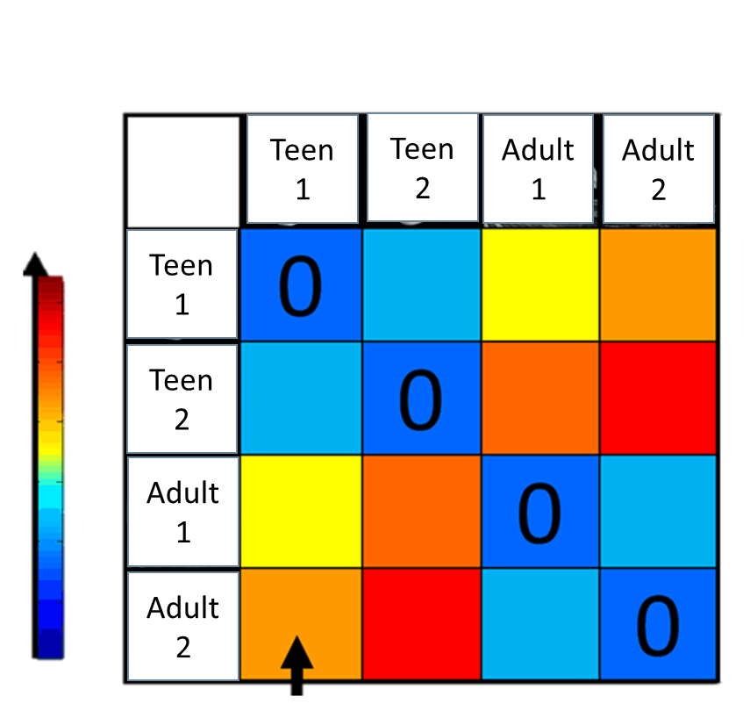
Ratings
Events Recalled
Chronology of Events
Detail of Events
Character Perceptions
Notes:
Identify how these unique idiosyncratic features are represented in the subsequent neural signal that we have

Slide 57


Adult
Adolescent
Notes:
Essentially, ideally, resulting in profiles for adults and adolescents in which features inform their social certainty judgments.

Slide 58
K00 Phase Post-Doc Research
Comparing the efficacy of and mechanisms
behind regulatory strategies to manage uncertainty.
Notes:
Of course, just knowing how certainty is formed is just a small piece of the puzzle
So in my much less well developed, but nonetheless present
Post-doc research proposal, I suggest exploring means of actually
Mitigating the extreme negative effects that uncertainty might present

Slide 59
If uncertainty is aversive . . .

Slide 60
If uncertainty is aversive . . .
and if adolescents aren’t great regulators. . .

Slide 61
If uncertainty is aversive . . .
and if adolescents aren’t great regulators. . .
might there be a more effective means
of regulating uncertainty-related affect?

Slide 62


Role play might be an especially effective means of self-regulating uncertainty when our proficiency with other strategies (i.e., reappraisals) have not yet fully developed

Slide 63
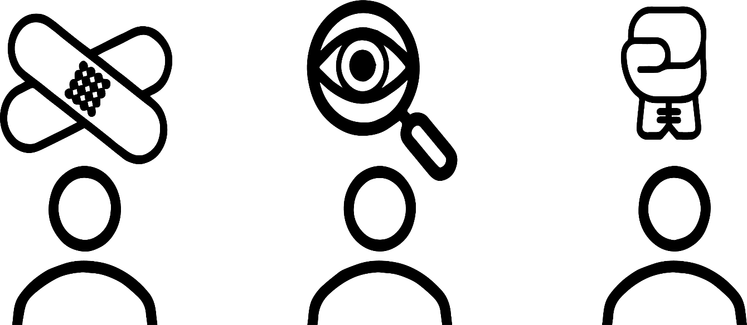
Friend of the Victim
Friend of the Accused
Detective

Slide 64
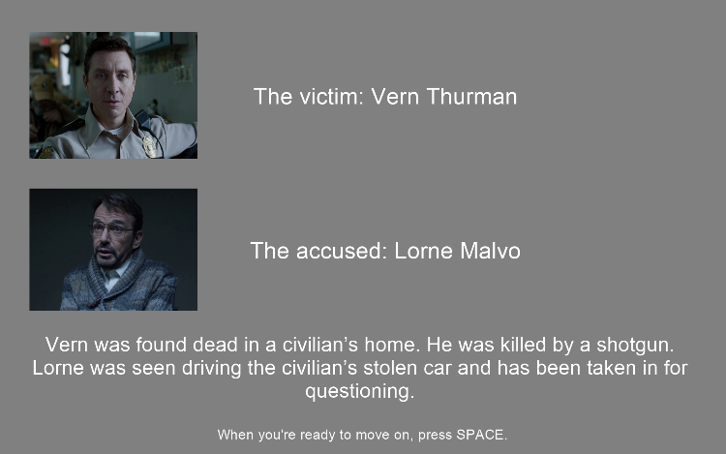
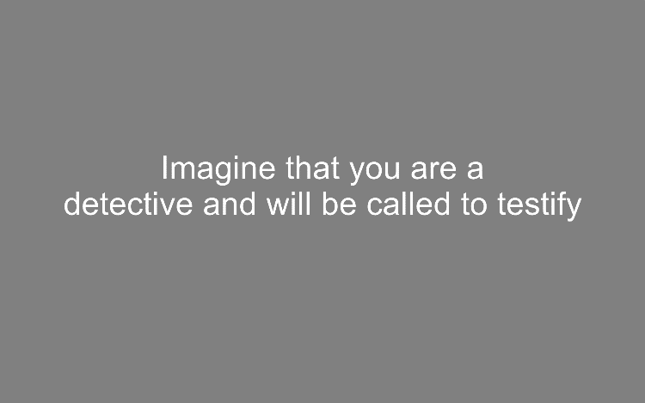
08s
02s
+
05s
ROLE REAPPRAISAL
NO MANIPULATION

Slide 65

08s
02s
+
05s
Aversive Video

Slide 66
08s
02s
+
05s
Aversive Video
Rating

Slide 67
Roadmap
Background
Project Summary & Significance
Analysis Details
Limitations, Issues, & Solutions
Strengths & Innovation
Future Directions

Slide 68
Limitations, Issues, & Solutions
Weak introduction

Slide 69
Limitations, Issues, & Solutions
Weak introduction
Cofounding hand movement and cognition
Notes:
One concern we had is whether or not the act of rating is adversely influence the neural activity that we actually see from participants

Slide 70
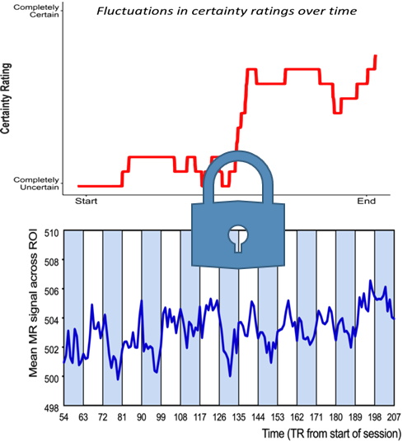
Limitations, Issues, & Solutions
Weak introduction
Cofounding hand movement and cognition
Notes:
Because ratings are time locked to neural activity,

Slide 71

Limitations, Issues, & Solutions
Weak introduction
Cofounding hand movement and cognition
Notes:
might the physical act of rating be what we’re seeing associations for.

Slide 72
Limitations, Issues, & Solutions
Weak introduction
Cofounding hand movement and cognition
Notes:
One advantage that we have is the fact that we only collected ratings for one half,
so I’m hopeful that we can apply a component analysis using data from the subject
and other subjects to identify how, if at all, hand movement is influencing this data.
This is still like a pipedream so if there are any suggestions here,
we’d love to hear them, although Chelsea might be ahead of me on this one

Slide 73
Limitations, Issues, & Solutions
Weak introduction
Cofounding hand movement and cognition
Only one half of video has ratings / Split sample

Slide 74
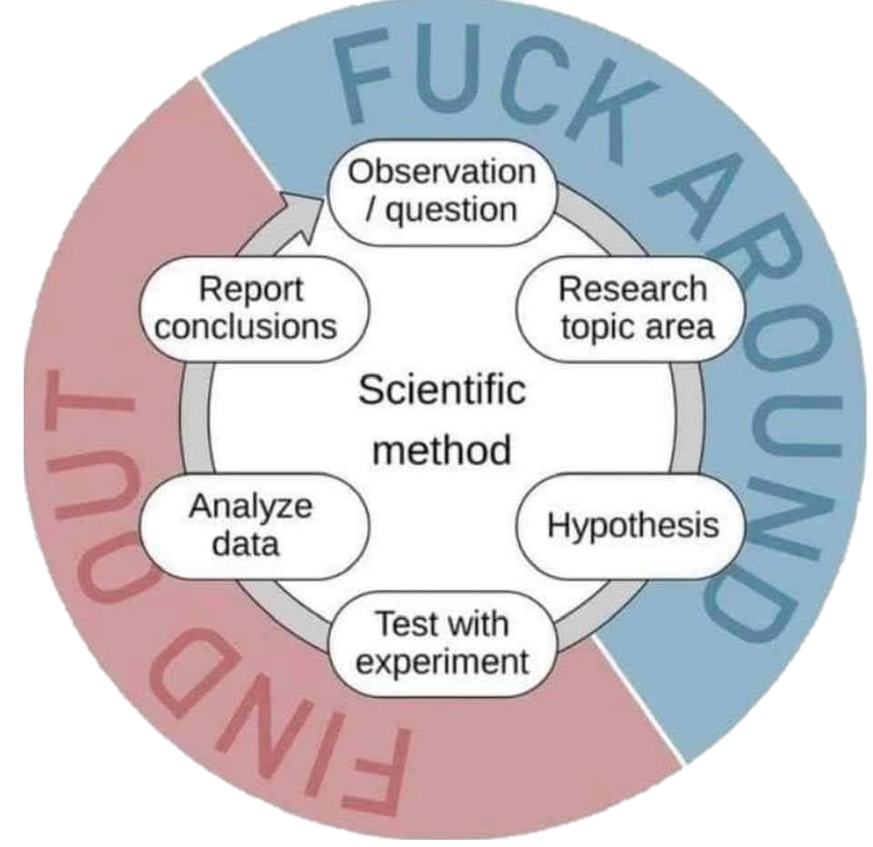

Limitations, Issues, & Solutions
Weak introduction
Cofounding hand movement and cognition
Only one half of video has ratings / Split sample
Notes:
We weren’t really sure that this would work. As best as we could tell it was a totally new approach.
We know passive video monitoring works so Chelsea had figured after consulting some other folks in this space
that if we have half our sample passively watching, at least we have something to work with if ratings don’t work out.
But this does give us a cool opportunity.

Slide 75




Limitations, Issues, & Solutions
Weak introduction
Cofounding hand movement and cognition
Only one half of video has ratings / Split sample
Group A
Group B
Notes:
One approach we’ve been exploring has been using data from the group that rated the video
In this case group A,

Slide 76
Limitations, Issues, & Solutions
Weak introduction
Cofounding hand movement and cognition
Only one half of video has ratings / Split sample
Notes:
to predict the neural data of group B
I think this is a little out there, not in terms of farfetchedness or anything
Just that it’s going to be tough to figure this out if we even can, but we’re pretty excited about it.

Slide 77

Limitations, Issues, & Solutions
Weak introduction
Cofounding hand movement and cognition
Only one half of video has ratings / Split sample
Tasks are not counterbalanced
Notes:
We want to limit exposure to the characters, setting, and plot prior to the ambiguity task, so we can’t put the control first
We can’t reverse the runs for continuity,
Free recall needs to follow social ambiguity task
I think it’s just a bug of the design but any suggestions would be appreciated

Slide 78
Limitations, Issues, & Solutions
Weak introduction
Cofounding hand movement and cognition
Only one half of video has ratings / Split sample
Tasks are not counterbalanced
Control task is short / not identical
Notes:
Our control task is only 1 run of 5 minutes, which gives us a limited window at a TR of 2 to explore which regions are responding.
Furthermore, because we’re using a slightly different stimulus, we can’t do a one to one comparison between social and non-social behavioral data.
Not using the exact same stimulus was necessary for the sake of free recall.

Slide 79

Limitations, Issues, & Solutions
Weak introduction
Cofounding hand movement and cognition
Only one half of video has ratings / Split sample
Tasks are not counterbalanced
Control task is short
No clear roadmap for analyses

Slide 80
Strengths & Innovations
Naturalistic design
Notes:
I’ve harped on the three ways I think that this design is really interesting and important.

Slide 81
Strengths & Innovations
Naturalistic design
Notes:
Continuity

Slide 82
Strengths & Innovations
Naturalistic design
Notes:
Feature rich stimulus

Slide 83
Strengths & Innovations
Naturalistic design
. . .
Notes:
Ambiguity

Slide 84
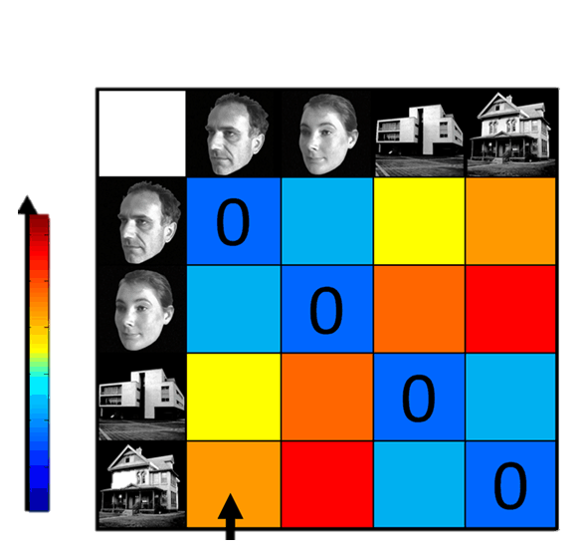
Strengths & Innovations
Naturalistic design
Novel analytic approaches
Notes:
I believe we’re the first to try to apply this analysis to these populations

Slide 85
Strengths & Innovations
Naturalistic design
Novel analytic approaches
Cross-domain comparisons
Notes:
As best as I know there’s only one other study that tried to explore social and non-social sources of ambiguity, but not with teens and not with naturalistic designs in the context of fMRI

Slide 86



Strengths & Innovations
Naturalistic design
Novel analytic approaches
Cross-domain comparisons
Multimodal representations

Slide 87
Strengths & Innovations
Naturalistic design
Novel analytic approaches
Cross-domain comparisons
Multimodal representations
Targeting key developmental stages

Slide 88

Future Directions
ISC analyses on adult (and adolescent?) sample
Notes:
I’ll only be able to carry out the proposed project if we get funding.
As such, I’m not counting my eggs before they hatch.
What I anticipate my dissertation will be is the series of analyses I outlined prior to getting into the prelim proposal
Using an ISC analysis. Of course, if the grant pans out, I’d love to include the adolescent sample in that.
At the time being, though, this developmental ISRSA project is contingent upon funding.

Slide 89
Future Directions
ISC analyses on adult (and adolescent?) sample
Development of tools relevant to this approach
Notes:
neuRotools
NaStiPy
ezRSA

Slide 90
Future Directions
ISC analyses on adult (and adolescent?) sample
Development of tools relevant to this approach
Expanding the paradigm
Notes:
Trying different stimuli
Capturing certainty judgments in more naturalistic contexts (i.e., election night)

Slide 91
That’s the presentation.

Slide 92
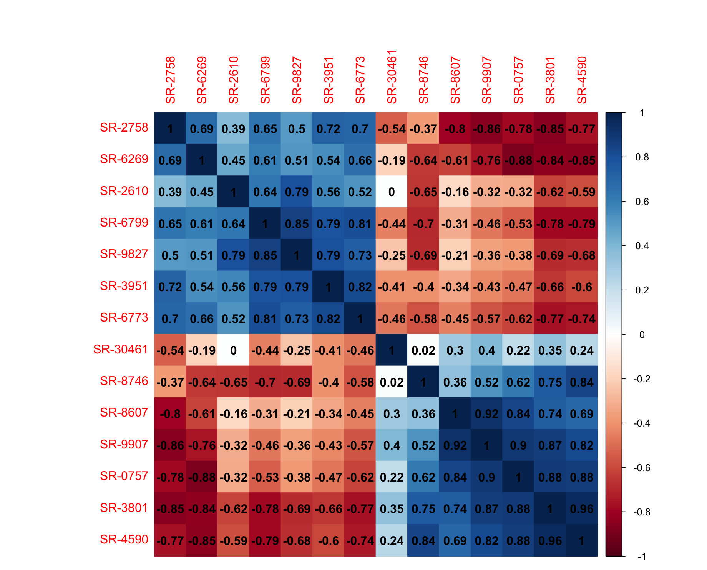




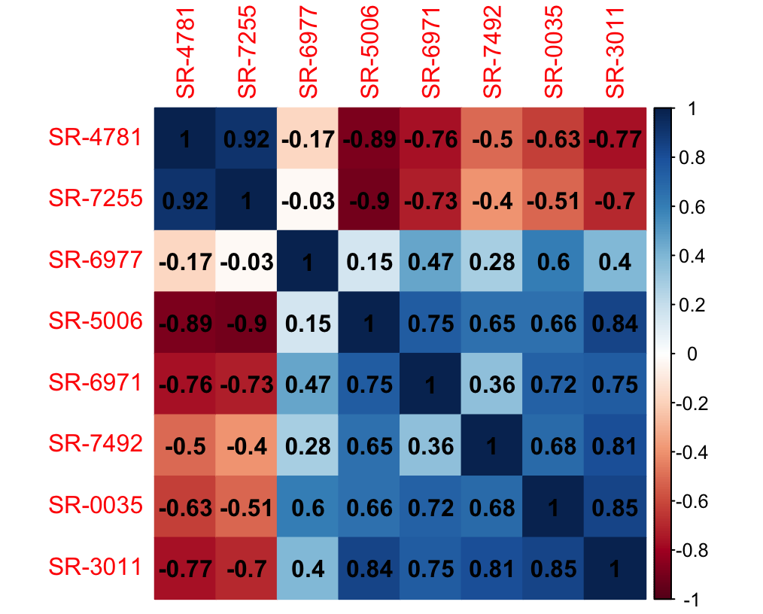
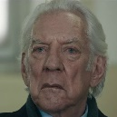



Slide 93
